Slide 1
What is basis?
A basis B of a vector space V is a linearly independent subset of V that spans V. This means that a subset B of V is a basis if it satisfies the two following conditions:
linear independence – only no collinear vectors
spanning property – for each vector v in V, there is one unique linear combination of vectors B that expresses it

Slide 2
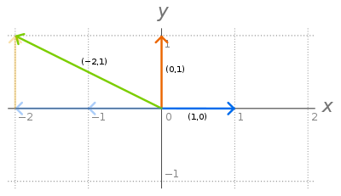
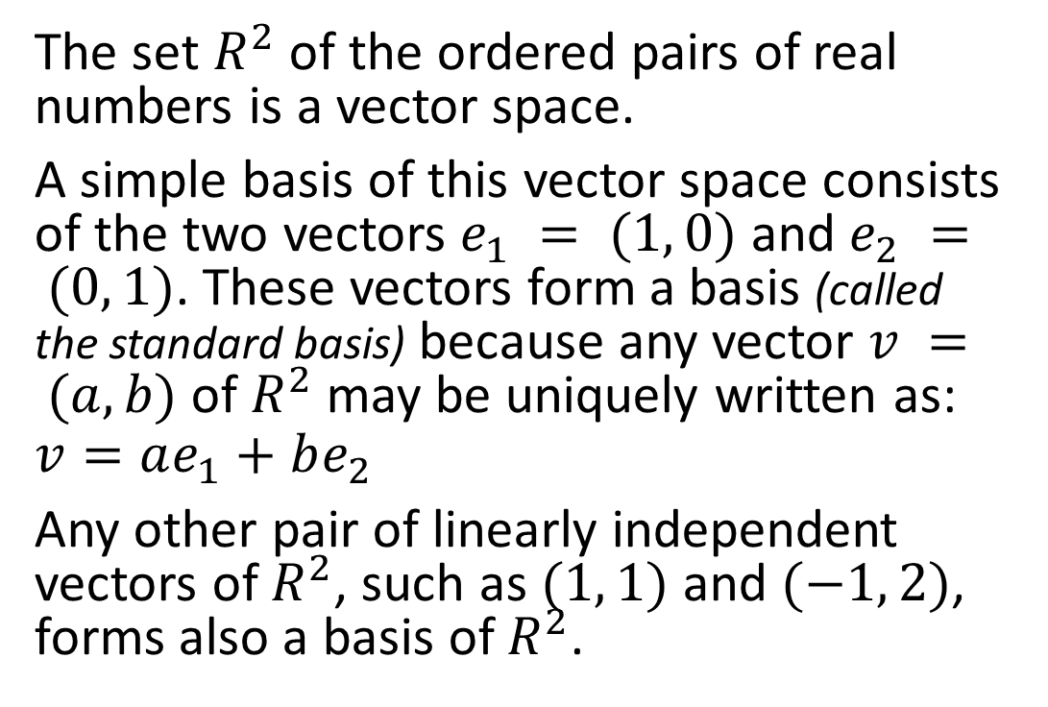
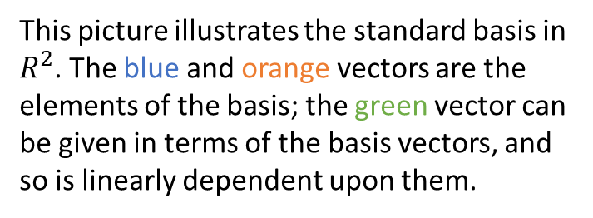
Example
The set $R^{2}$ of the ordered pairs of real numbers is a vector space.
A simple basis of this vector space consists of the two vectors $e_{1} = (1, 0)$ and $e_{2} = (0, 1)$. These vectors form a basis (called the standard basis) because any vector $v = (a, b)$ of $R^{2}$ may be uniquely written as:
$$v=ae_{1}+be_{2}$$
Any other pair of linearly independent vectors of $R^{2}$, such as $(1, 1)$ and $(−1, 2)$, forms also a basis of $R^{2}$.
This picture illustrates the standard basis in $R^{2}$. The blue and orange vectors are the elements of the basis; the green vector can be given in terms of the basis vectors, and so is linearly dependent upon them.

